Slide 1
Introduction
Look at
Mprocessor’s internal programming model and then how its memory space is addressed.
Addressing modes for this powerful family of microprocessors
  the real,
  protected, and
  flat modes of operation.

Slide 2
2–1 INTERNAL MICROPROCESSOR ARCHITECTURE
Before a program is written or instruction investigated, internal configuration of the microprocessor must be known.
In a multiple core microprocessor each core contains the same programming model.
Each core runs a separate task or thread simultaneously.

Slide 3
The Programming Model
8086 through Core2 considered program visible registers.
  registers are used during programming and are specified by the instructions
Other registers considered to be program invisible.
  not addressable directly during applications programming

Slide 4
80286 and above contain program-invisible registers to control and operate protected memory.
  and other features of the microprocessor
80386 through Core2 microprocessors contain full 32-bit internal architectures.
8086 through the 80286 are fully upward-compatible to the 80386 through Core2.

Slide 5
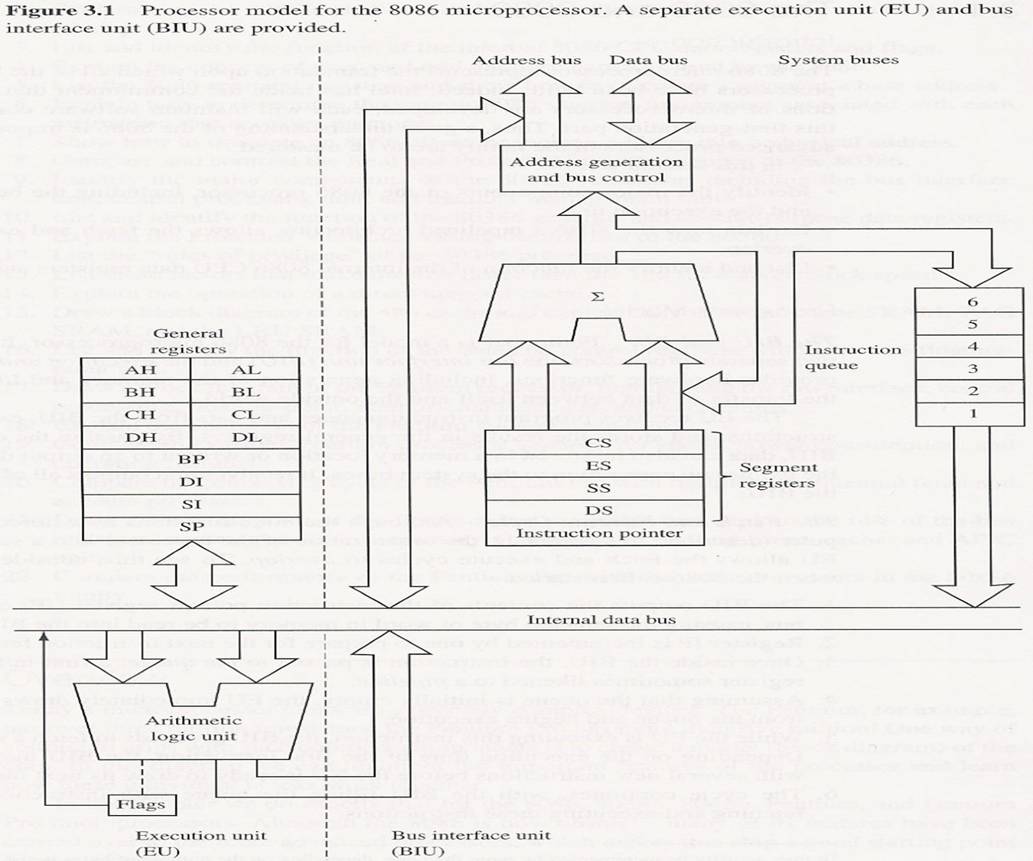

Slide 6
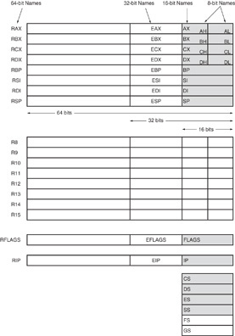
Figure 2–1 The programming model of the 8086 through the Core2 microprocessor including the 64-bit extensions.

Slide 7
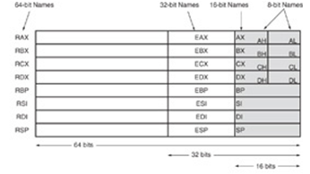
Multipurpose Registers: The programming model of the 8086 through the Core2 microprocessor including the 64-bit extensions.
RAX - a 64-bit register (RAX), a 32-bit register (accumulator) (EAX), a 16-bit register (AX), or as either of two 8-bit registers (AH and AL).
used for instructions such as multiplication, division, and some of the adjustment instructions
In 80386 and above EAX may hold the offset address of a memory location
RBX, addressable as RBX, EBX, BX, BH, BL.
  BX register (base index) sometimes holds offset address of a location in the memory system in all versions of the microprocessor
RCX, as RCX, ECX, CX, CH, or CL.
  a (count) general-purpose register that also holds the count for various instructions (repeat, shift, rotate, loop)
RDX, as RDX, EDX, DX, DH, or DL.
  a (data) general-purpose register
  holds a part of the result from a multiplication
  or part of dividend before a division

Slide 8
Multipurpose Registers: The programming model of the 8086 through the Core2 microprocessor including the 64-bit extensions.
RBP, as RBP, EBP, or BP.
  points to a memory (base pointer) location for memory data transfers
RDI addressable as RDI, EDI, or DI.
  often addresses (destination index) string destination data for the string instructions
RSI used as RSI, ESI, or SI.
  the (source index) register addresses source string data for the string instructions
  like RDI, RSI also functions as a general-
  purpose register

Slide 9
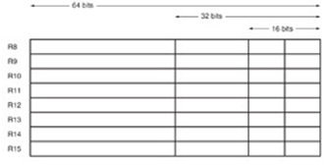
The 64 bit Registers
R8 - R15 found in the Pentium 4 and Core2 if 64-bit extensions are enabled.
  data are addressed as 64-, 32-, 16-, or 8-bit
  sizes and are of general purpose
Most applications will not use these registers until 64-bit processors are common.
  the 8-bit portion is the rightmost 8-bit only
  bits 8 to 15 are not directly addressable as
  a byte

Slide 10
The 64 bit Registers
Register size | Override | Bits accesses | Example
8 bits | B | 7-0 | MOV R19B, R10B
16 bits | W | 15-0 | MOV R10W, AX
32 bits | D | 31-0 | MOV R14D, R15D
64 bits | - | 63-0 | MOV R13, R12

Slide 11
Special-Purpose Registers
Include RIP, RSP, and RFLAGS
  segment registers include CS, DS, ES, SS, FS, and GS
  RIP - instruction pointer
  addresses the next instruction in code section
RSP - stack pointer
  addresses an area of memory called
  the stack.

Slide 12
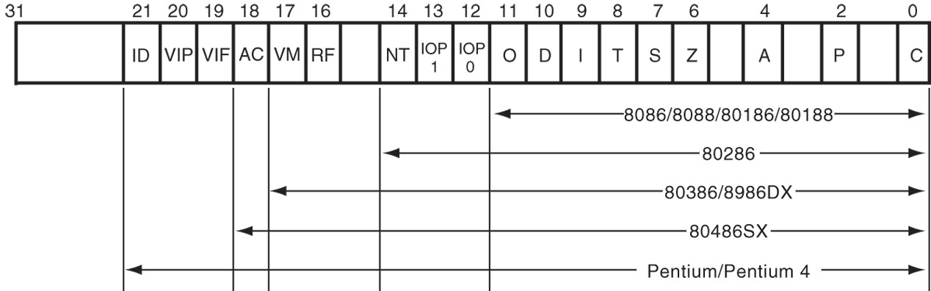
RFLAGS - The EFLAG and FLAG register counts for the entire 8086 and Pentium microprocessor family.
Flags are upward-compatible from the 8086/8088 through Core2 .
The rightmost five and the overflow flag are changed by most arithmetic and logic operations.
Flags never change for any data transfer or program control operation.

Slide 13
C (carry) holds the carry after addition or borrow after subtraction.
  also indicates error conditions
P (parity) is the count of ones in a number expressed as even or odd. Logic 0 for odd parity; logic 1 for even parity.
A (auxiliary carry) holds the carry (half-carry) after addition or the borrow after subtraction between bit positions 3 and 4 of the result.
Z (zero) shows that the result of an arithmetic or logic operation is zero.
S (sign) flag holds the arithmetic sign of the result after an arithmetic or logic instruction executes.

Slide 14
T (trap) The trap flag enables trapping through an on-chip debugging feature.
I (interrupt) controls operation of the INTR (interrupt request) input pin.
  Enables or disables interrrupts
  Contolled by STI and CLI instructions
D (direction) selects increment or decrement mode for the DI and/or SI registers.
  Set by STD and cleared by CLD instructions
O (overflow) occurs when signed numbers are added or subtracted.
  an overflow indicates the result has exceeded the capacity of the machine

Slide 15
IOPL used in protected mode operation to select the privilege level for I/O devices. If I/O privelage level of a requesting device is higher, an iterrupt occurs (IOPL=00 highest; IOPL=00 lowest).
NT (nested task) flag indicates the current task is nested within another task in protected mode operation.
RF (resume) used with debugging to control resumption of execution after the next instruction.
VM (virtual mode) flag bit selects virtual mode operation in a protected mode system. VM is used to simulate DOS in the modern Windows environment.

Slide 16
AC, (alignment check) flag bit activates if a word or doubleword is addressed on a non-word or non-doubleword boundary.
VIF –(virtual interrupt) is a copy of the interrupt flag bit available to the Pentium 4
VIP (virtual interrupt pending) provides information about a virtual mode interrupt for Pentium.
  used in multitasking environments to provide virtual interrupt flags
ID (identification) flag indicates that the Pentium microprocessors support the CPUID instruction.
  CPUID instruction provides the system with information about the Pentium microprocessor

Slide 17
Segment Registers
Generate memory addresses when combined with other registers in the microprocessor.
Four or six segment registers in various versions of the microprocessor.
A segment register functions differently in real mode than in protected mode.
Following is a list of each segment register, along with its function in the system.

Slide 18
CS (code) segment holds code (programs and procedures) used by the microprocessor.
DS (data) contains most data used by a program.
  Data are accessed by an offset address or contents of other registers that hold the offset address
ES (extra) an additional data segment used by some instructions to hold destination data.

Slide 19
SS (stack) defines the area of memory used for the stack.
  stack entry point is determined by the stack segment and stack pointer registers
  the BP register also addresses data within
  the stack segment

Slide 20
FS and GS segments are supplemental segment registers available in 80386–Core2 microprocessors.
  allow two additional memory segments for
  access by programs
Windows uses these segments for internal operations, but no definition of their usage
is available.

Slide 21
2–2 REAL MODE MEMORY ADDRESSING
80286 and above operate in either the real or protected mode.
Real mode operation allows addressing of only the first 1M byte of memory space—even in Pentium 4 or Core2 microprocessor.
  the first 1M byte of memory is called the real memory, conventional memory, or DOS memory system

Slide 22
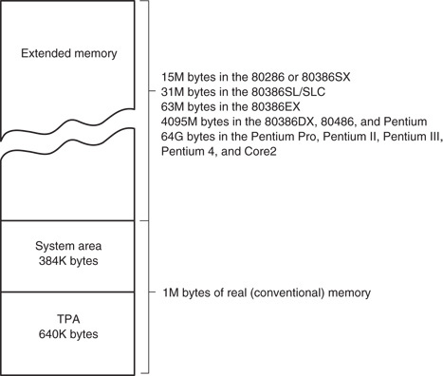

Slide 23
Segments and Offsets
All real mode memory addresses must consist of a segment address plus an offset address.
  segment address defines the beginning address of any 64K-byte memory segment
  offset address selects any location within the
  64K byte memory segment
Figure 2–3 shows how the segment plus offset addressing scheme selects a memory location.

Slide 24
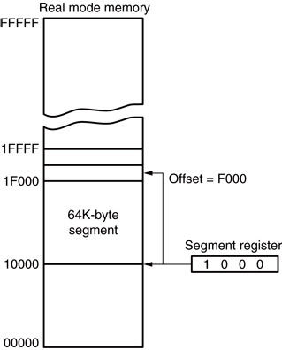
Figure 2–3 The real mode memory-addressing scheme, using a segment address plus an offset.
  this shows a memory segment beginning at 10000H, ending at location IFFFFH
    64K bytes in length
  also shows how an offset address, called a displacement, of F000H selects location
  1F000H in the memory

Slide 25
Once the beginning address is known, the ending address is found by adding FFFFH.
  because a real mode segment of memory is64K in length
The offset address is always added to the segment starting address to locate the data.
Segment and offset address is sometimes written as 1000:2000.
  a segment address of 1000H; an offset of 2000H
  Memory address is 10000 + 2000 = 12000H

Slide 26
Example:
For the memory location whose physical address is specified by 1256AH, give the address in segment: offset form for segments 1256H and 1240H.
Solution:
Let X be the offset in segment 1256h and Y the offset in segment 1240h. We have.
1256Ah = 12560h + X and 1256Ah = l2400h + Y
and so
X = l 256Ah – 12560H = AH and Y = 12566Ah – 12400H = l 6Ah
thus-
1256Ah =.1256:000A = 1240:016A

Slide 27
Default Segment and Offset Registers
The microprocessor has rules that apply to segments whenever memory is addressed.
  these define the segment and offset register combination
Address of an Instruction
  The code segment register defines the start of the code segment.
  The instruction pointer locates the next instruction within the code segment.
  The address of the instruction is CS:IP

Slide 28
Another of the default combinations is the stack.
  stack data are referenced through the stack segment at the memory location addressed by either the stack pointer (SP/ESP) or the pointer (BP/EBP)
Segment | Offset | Special Purpose
CS | IP | Instruction address
SS | SP or BP | Stack address
DS | BX, DI, SI, an 8- or 16-bit number | Data address
ES | DI for string instructions | String destination address

Slide 29
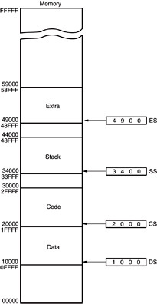
Figure 2–4 A memory system showing the placement of four memory segments.
  a memory segment can touch or overlap if 64K bytes of memory are not required for a segment
  think of segments as windows that can be moved over any area of memory to access data or code
  a program can have more than four or six segments,
      but only access four or six segments at a time

Slide 30
  a program placed in memory by DOS is loaded in the TPA at the first available area of memory above drivers and other TPA programs
  area is indicated by a free-pointer maintained by DOS
  program loading is handled automatically by the program loader within DOS

Slide 31
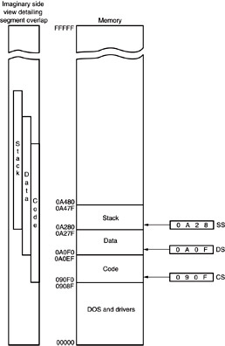
Figure 2–5 An application program containing a code, data, and stack segment loaded into a DOS system memory.
  Example:
  Suppose an application program requires
    1000H bytes for code
    190H bytes for data
    200H bytes for stack
  CS: 090F -> end address 090F0H + 1000H = 0A0F0H
  DS: 0A0F -> end address 0A0F0H + 190H = 0A280H
  SS: 0A28 -> end addrss 0A280H + 200H = 0A480

Slide 32
Segment and Offset Addressing Scheme Allows Relocation
Segment plus offset addressing allows DOS programs to be relocated in memory.
A relocatable program is one that can be placed into any area of memory and executed without change.
Relocatable data are data that can be placed in any area of memory and used without any change to the program.

Slide 33
Because memory is addressed within a segment by an offset address, the memory segment can be moved to any place in the memory system without changing any of the offset addresses.
Only the contents of the segment register must be changed to address the program
in the new area of memory.
Windows programs are written assuming that the first 2G of memory are available for code and data.

Slide 34
2–3 INTRO TO PROTECTED MODE
MEMORY ADDRESSING
Allows access to data and programs located within & above the first 1M byte of memory.
Protected mode is where Windows operates.
In place of a segment address, the segment register contains a selector that selects a descriptor from a descriptor table.
The descriptor describes the memory segment’s location, length, and access rights.

Slide 35
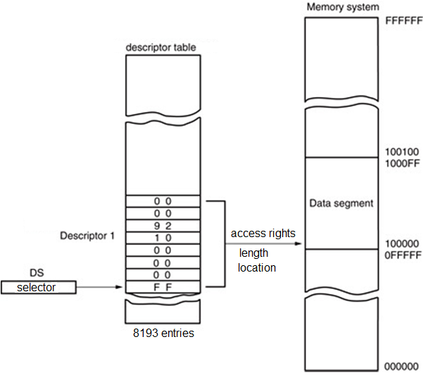
In protected mode, this segment number can address any memory location in the system for the code segment.
Indirectly, the register still selects a memory segment, but not directly as in real mode.

Slide 36
Global descriptors contain segment definitions that apply to all programs.
Local descriptors are usually unique to an application.
  a global descriptor might be called a system descriptor, and local descriptor an application descriptor
  each descriptor is 8 bytes in length
  global and local descriptor tables are a
  maximum of 64K (8 x 8193) bytes in length

Slide 37
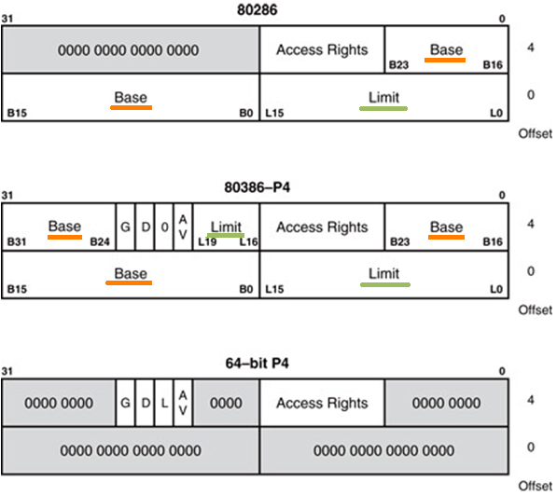
Figure 2–6 The 80286 through Core2 64-bit descriptors.
Base: 24 bits
Limit: 16 bits
Base: 32 bits
Limit: 20 bits

Slide 38
The base address of the descriptor indicates the starting location of the memory segment.
  the paragraph boundary limitation is removed in protected mode
  segments may begin at any address
The G, or granularity bit allows a segment length of 4K to 4G bytes in steps of 4K bytes.
  32-bit offset address allows segment lengths of 4G bytes
  16-bit offset address allows segment lengths of 64K bytes.

Slide 39
If G = 0 → limit is between 00000H – FFFFFH
If G = 1 → The value of the limit is appended by 4K bytes (append FFFH)
Example 1
Base = Start = 10000000H, Limit = 001FFH
If
  G = 0
  End = Base + Limit = 10000000H + 001FFH = 100001FFH
If
  G = 1
  End = Base + Limit = 10000000H + 001FFFFFH = 101FFFFFH
  Thus, The G, or granularity bit allows a segment length of 4K to 4G bytes in steps of 4K

Slide 40
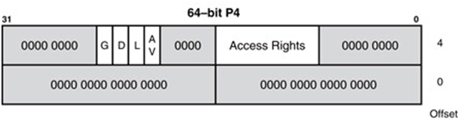
In 64 bit mode
L = 1 → 64 address modein Pentium 4 or Core 2
L = 0 → 32 bit compatible
There are only Access rights and control bits
The base address is assumed to be at 00 0000 0000H
There is no limit check

Slide 41
AV bit shows availability
  AV = 0 → the segment is available
  AV = 1 → the segment is available
D bit shows the mode
  D = 0 → 16 bit instructions and data
  D = 1 → 32 bit instructions and data

Slide 42
The access rights byte controls access to the protected mode segment.
  describes segment function in the system and allows complete control over the segment
  if the segment is a data segment, the direction of growth is specified
If the segment grows beyond its limit, the operating system is interrupted, indicating
a general protection fault.
You can specify whether a data segment
can be written or is write-protected.

Slide 43
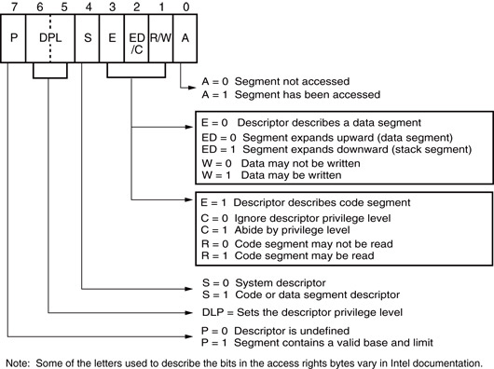
Figure 2–7 The access rights byte for the 80286 through Core2 descriptor.

Slide 44
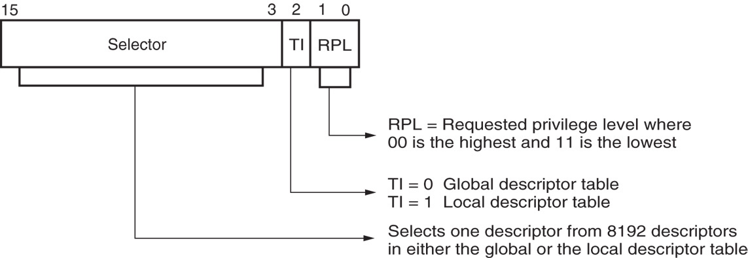
Descriptors are chosen from the descriptor table by the segment register.
  register contains a 13-bit selector field, a table selector bit, and requested privilege level field
Requested Privilege Level (RPL) requests the access privilege level of a memory segment.
  If privilege levels are violated, system normally indicates an application or privilege level violation

Slide 45
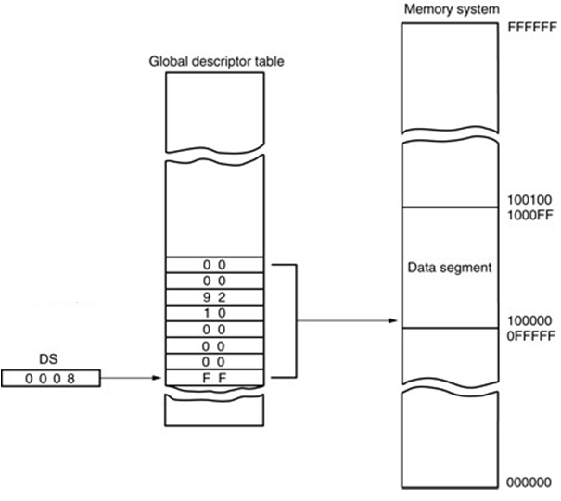
Figure 2–9 Using the DS register to select a description from the global descriptor table. In this example, the DS register accesses memory locations 00100000H–001000FFH as a data segment.
The entry in the global descriptor table selects a segment in the memory system.
Descriptor zero is called the null descriptor, must contain all zeros, and may not be used for accessing memory.

Slide 46
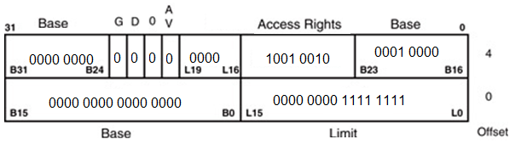
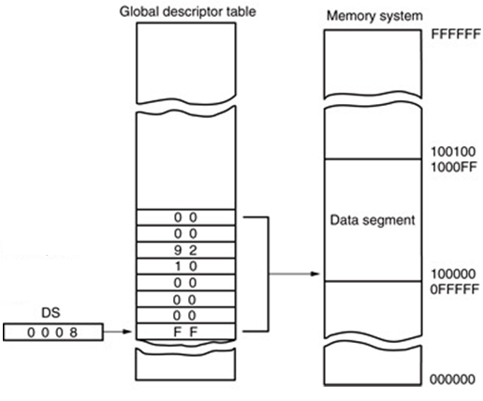
Base: 0010 0000H
Limit: 000FFH
Data segment with address range:
0010 0000 – 0010 00FF

Slide 47
Program-Invisible Registers
Global and local descriptor tables are found
in the memory system.
To access & specify the table addresses, 80286–Core2 contain program-invisible registers.
  not directly addressed by software
Each segment register contains a program-invisible portion used in the protected mode.
  often called cache memory because cache is
  any memory that stores information

Slide 48
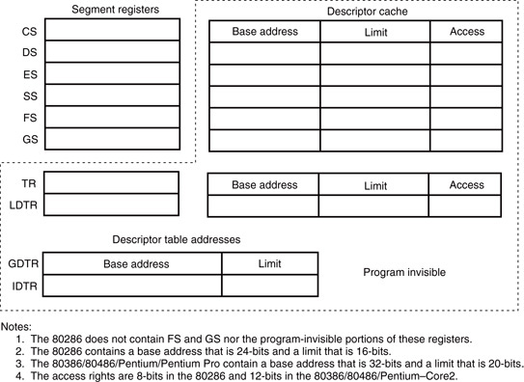
Figure 2–10 The program-invisible register within the 80286–Core2 microprocessors.

Slide 49
When a new segment number is placed in a segment register, the microprocessor accesses a descriptor table and loads the descriptor into the program-invisible portion of the segment register.
  held there and used to access the memory segment until the segment number is changed
This allows the microprocessor to repeatedly access a memory segment without referring to the descriptor table.
  hence the term cache

Slide 50
The GDTR (global descriptor table register) and IDTR (interrupt descriptor table register) contain the base address of the descriptor table and its limit.
  when protected mode operation desired, address of the global descriptor table and its limit are loaded into the GDTR
The location of the local descriptor table is selected from the global descriptor table.
  one of the global descriptors is set up to
  address the local descriptor table

Slide 51
To access the local descriptor table, the LDTR (local descriptor table register) is loaded with a selector.
  selector accesses global descriptor table, & loads local descriptor table address, limit, & access rights into the cache portion of the LDTR
The TR (task register) holds a selector, which accesses a descriptor that defines a task.
  a task is most often a procedure or application
Allows multitasking systems to switch tasks
to another in a simple and orderly fashion.

Slide 52
2–4 MEMORY PAGING
The memory paging mechanism allows any physical memory location to be assigned to any linear address.
  Iinear address is defined as the address generated by a program.
  Physical address is the actual memory location accessed by a program.
With memory paging, the linear address is invisibly translated to any physical address.

Slide 53
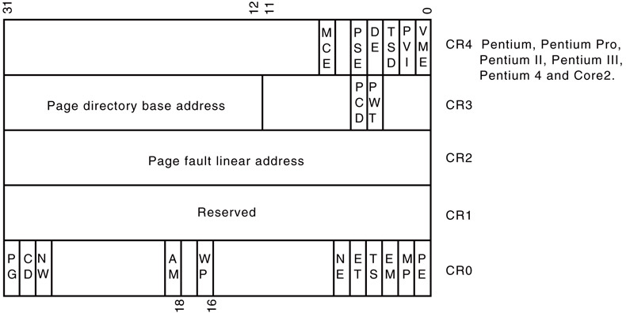
Paging Registers
The paging unit is controlled by the contents
of the microprocessor’s control registers.
Beginning with Pentium, an additional control register labeled CR4 controls extensions to the basic architecture.

Slide 54
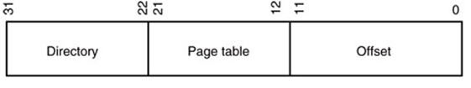
The linear address, as generated by software, is broken into three sections that are used to access the page directory entry, page table entry, and memory page offset address.

Slide 55
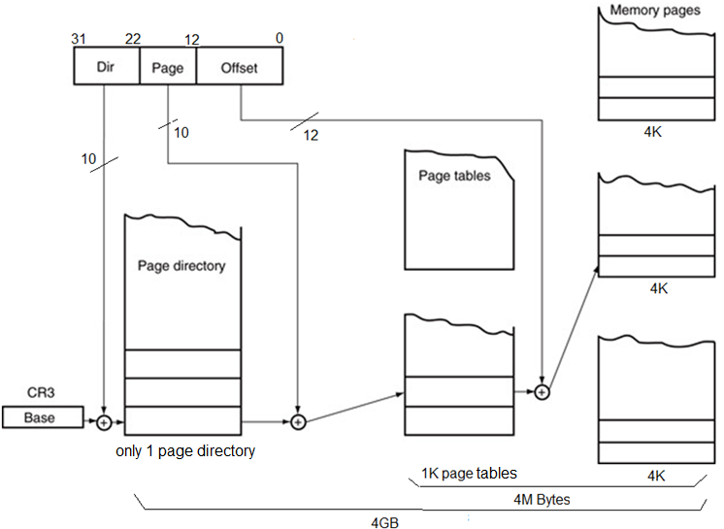
Figure 2–13 The paging mechanism in the 80386 through Core2 microprocessors.

Slide 56
Intel has incorporated a special type of cache called TLB (translation look-aside buffer).
  because repaging a 4K-byte section of memory requires access to the page directory and a page table, both located in memory
The 80486 cache holds the 32 most recent page translation addresses.
  if the same area of memory is accessed, the address is already present in the TLB
  This speeds program execution
Pentium contains separate TLBs for each
of their instruction and data caches.

Slide 57
2–5 Flat Mode Memory
A flat mode memory system is one in which there is no segmentation.
  does not use a segment register to address a location in the memory
First byte address is at 00 0000 0000H; the last location is at FF FFFF FFFFH.
  address is 40-bits
The segment register still selects the privilege level of the software.

Slide 58
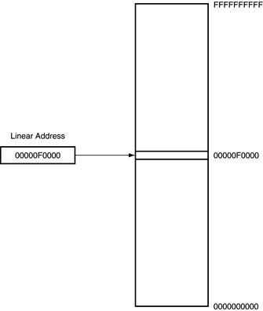
Figure 2–15 The 64-bit flat mode memory model.
The flat mode memory contains 1T byte of memory using a 40-bit address.
In the future, Intel plans to increase the address width to 52 bits to access 4P bytes of memory.
The flat mode is only available in the Pentium 4 and Core2 that have their64-bit extensions enabled.

